Slide 1

HTML5 & CSS3
Fundamentals
Week 1 – Day 4

Slide 2
Welcome
Tanveer Ahmad
Technical Trainer
DPP

Slide 3
Media query
Media query is used in CSS3 for responsive web design.
It uses the @media rule to include a block of CSS properties only if a certain condition is true.
Example: If the browser window is 600px or smaller, the background color will change to grey:
@media only screen and (max-width: 600px) { body { background-color: grey;
font-size: 0.8em;
color: white; } }

Slide 4
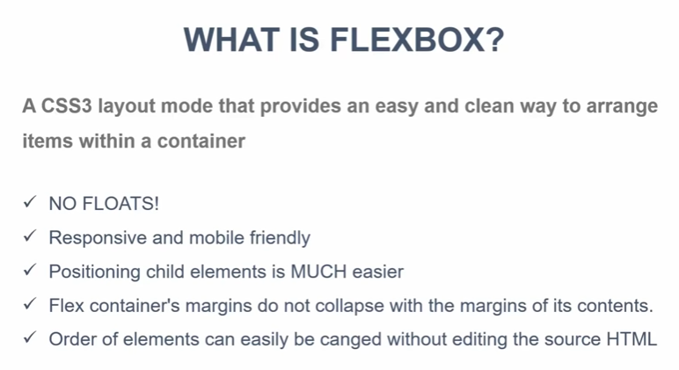
FlexBox

Slide 5
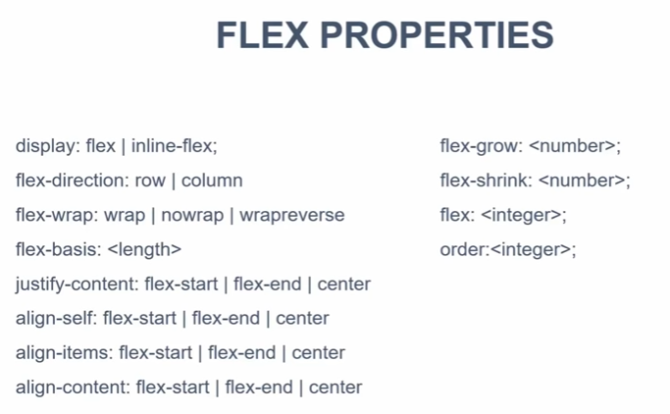
https://www.youtube.com/watch?v=JJSoEo8JSnc

Slide 6

Flexbox Layout
The Flexible Box Layout Module, makes it easier to design flexible responsive layout structure without using float or positioning.
To start using the Flexbox model, you need to first define a flex container.
The element below represents a flex container (the blue area) with three flex items.
The flex container becomes flexible by setting the display property to flex:
.flex-container { display: flex; }

Slide 7
Grid and Flexbox
https://www.youtube.com/watch?v=RSIclWvNTdQ

Slide 8
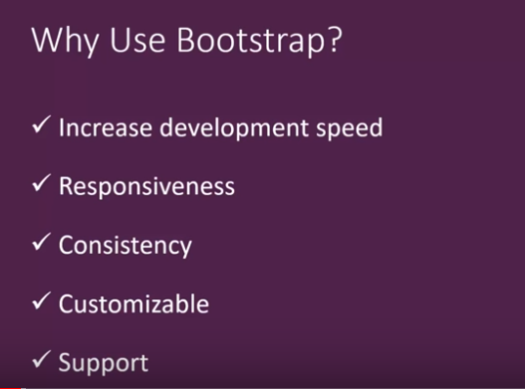
Bootstrap
https://getbootstrap.com/

Slide 9
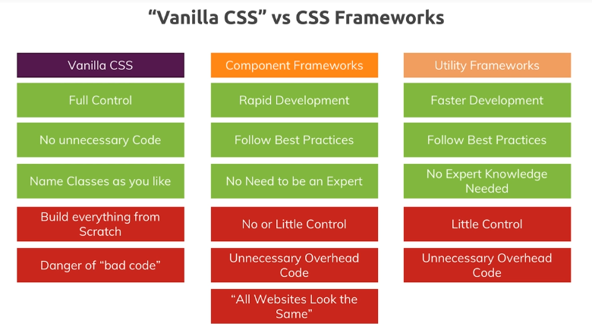
Vanilla, Bootstrap and Tailwindcss

Slide 10
Bootstrap Timeline
Get HTML/CSS from the following link and customise it in your website:
https://bootsnipp.com/tags/timeline
Create a separate file for the CSS styles and link it in <head> tag.

Slide 11
Boostrap templates
Templates
https://getbootstrap.com/docs/4.3/examples/
Code examples
https://getbootstrap.com/docs/4.3/components/forms/

Slide 12
Hamburger menu
We will be using just HTML/CSS using checkbox
<div class="nav2">
<label for="toggle"> &#9776; </label>
<input type="checkbox" id="toggle">
<div class="menu">
<a href="#"> Home</a>
<a href="#"> Services</a>
<a href="#"> Business</a>
<a href="#"> Contact</a>
</div>
</div>

Slide 13
Project: ABC web design
Home page:
About Us:
Services:
Contact
Using the following skills
Header, Nav, Sections, Divs, Article, Aside, UL, Boxes, Showcase, Forms, Footer
CSS styles including media queries.

Slide 14
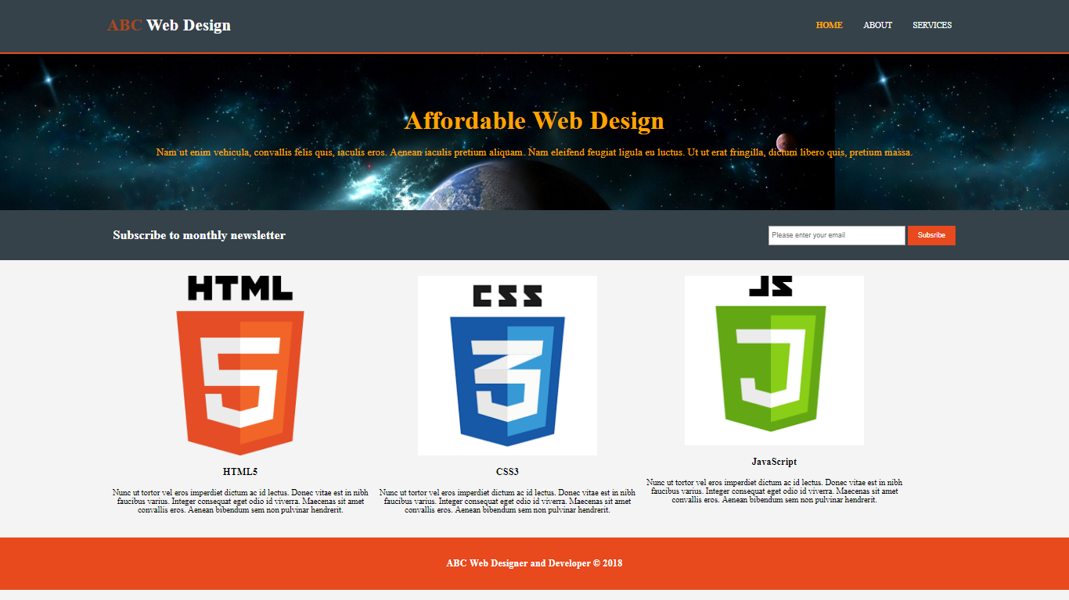
Home page

Slide 15
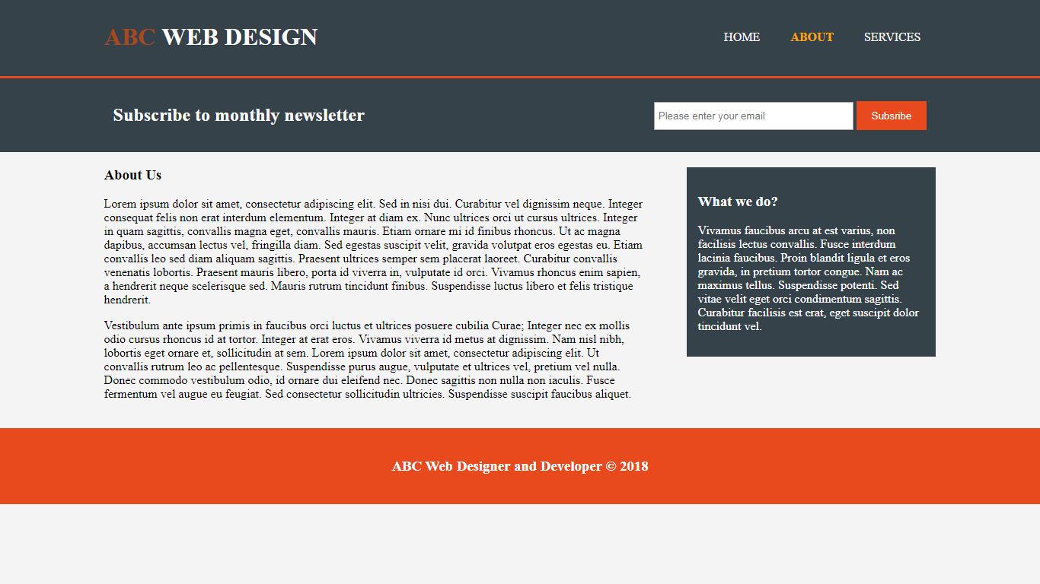
About page

Slide 16
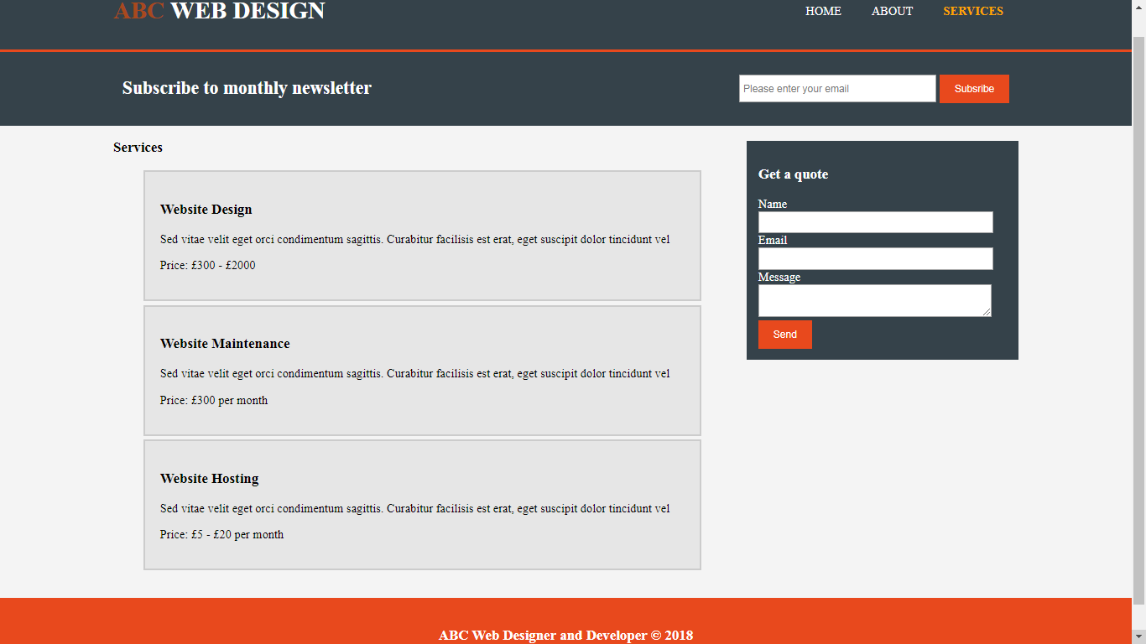
Services page

Slide 17
Useful Websites
https://www.tutorialspoint.com/
https://www.w3schools.com
www.youtube.com
https://css-tricks.com/snippets/css/a-guide-to-flexbox/

